Slide 1
Pengenalan Machine Learning
Lokakarya Machine Learning untuk Pemula
5-6 Juli 2018, Universitas Pertamina

Slide 2
Outline
Era Artificial Intelligence
Perbedaan Artificial Intelligence, Data Science, dan Machine Learning
Statistika dan Machine Learning
Tugas-tugas Machine Learning
Machine Learning Saat Ini

Slide 3
Era Artificial Intelligence
Apakah AI itu? Secara sederhana, AI adalah mesin yang mampu berpikir sebagaimana manusia berpikir https://www.informationweek.com/big-data/12-artificial-intelligence-terms-you-need-to-know/d/d-id/1330003?page_number=2

Slide 4
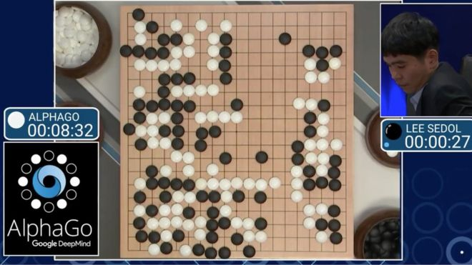
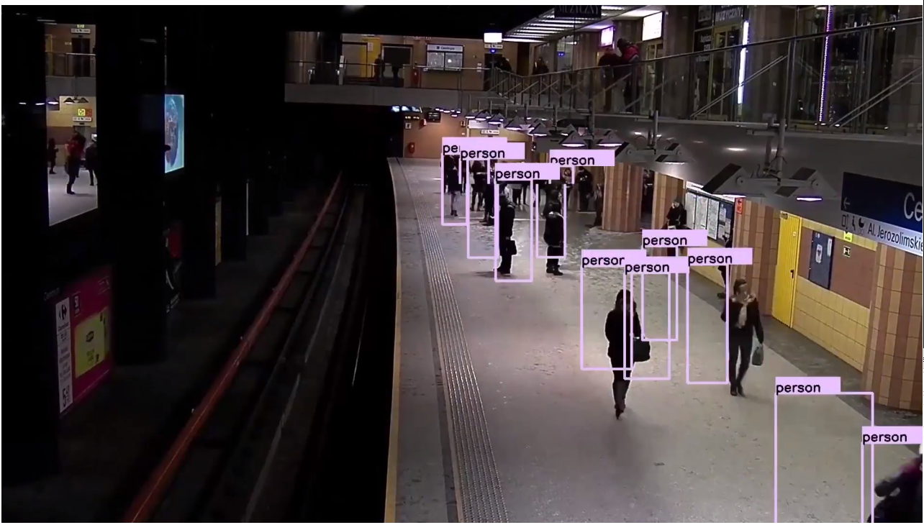
Era Artificial Intelligence
Bermain permainan Go
(Sumber Gambar: bbc.co.uk)
Deteksi Objek
(Sumber Gambar: www.youtube.com/watch?v=9z5CesxutEg)
https://www.youtube.com/watch?v=R0zSEJuY68I

Slide 5
Era Artificial Intelligence
AI: Anak dari tiga orang tua (Sumber: www.luxoft.com/blog/mdillon/journeys-in-data-science-part-4-the-growth-of-ai-machine-learning/)
• Data - Pada 2013, ‘big data’ adalah buzzword utama. Menurut IBM, 90% data di seluruh duniaThink back to 2013 when ‘big data’ was the buzzword. According to IBM, 90% of the entire world's recorded data was created in the last two years! That works into AI, as it needs vast amounts of data to train necessary algorithms. And the right training data set is absolutely essential for accurate AI-based predictions. • Computing Power – Specifically, cloud. Over the last couple of years, cloud services have become a commodity nearly all industries rely on. Beyond storage and the principle extract, transform, load (ETL,) you now have accessible, affordable and powerful analytics at your disposal. • Algorithms - When referring to algorithms in AI, the majority are utilised by machines to learn – hence the term ‘machine learning’ (ML). While the algorithms used in AI & ML have been around for decades, we haven’t had the necessary computational power nor architecture to fully exploit them – until now.

Slide 6
Era Artificial Intelligence: Pertumbuhan Data
https://www.forbes.com/sites/bernardmarr/2015/09/30/big-data-20-mind-boggling-facts-everyone-must-read/#2f21b37d17b1
Data is growing faster than ever before and by the year 2020, about 1.7 megabytes of new information will be created every second for every human being on the planet.
By then, our accumulated digital universe of data will grow from 4.4 zettabyets today to around 44 zettabytes, or 44 trilliongigabytes
In 2015, a staggering 1 trillion photos will be taken and billions of them will be shared online. By 2017, nearly 80% of photos will be taken on smart phones.
This year, over 1.4 billion smart phones will be shipped - all packed with sensors capable of collecting all kinds of data, not to mention the data the users create themselves.
And one of my favourite facts: At the moment less than 0.5% of all data is ever analysed and used, just imagine the potential here.

Slide 7
Apa itu Machine Learning?
Machine Learning:
Upaya mesin untuk « belajar » mengenai karakteristik suatu kasus/data agar mendekati hasil terbaik dengan algoritma tertentu
AI menggunakan machine learning untuk membantu menentukan keputusan

Slide 8
Apa itu Machine Learning?
AI
Keputusan
Data
Machine Learning
Semakin baik hasil Machine Learning-nya, semakin baik keputusan yang bisa diperoleh AI

Slide 9
Perbedaan Artificial Intelligence, Data Science, dan Machine Learning
Data Science:
Bidang ilmu yang mencakup semua hal terkait data
Pembersihan data
Koleksi data
Penarikan kesimpulan
Statistika
Dst
Cenderung melibatkan manusia dalam prosesnya, tetapi tetap juga membutuhkan otomatisasi dalam beberapa hal

Slide 10
Perbedaan Artificial Intelligence, Data Science, dan Machine Learning
Data Processing
Reasoning
Data Science
Artificial Intelligence
Machine Learning
Deep Learning
Data Visualization
Data Integration
Rules Extraction
Data Engineering
AI Tasks

Slide 11
Statistika dan Machine Learning
Statistika:
Memodelkan hubungan antarvariabel dengan asumsi-asumsi tertentu
Cenderung menganalisis data yang sedikit
Machine learning:
Berorientasi pada baik/buruknya hasil yang diperoleh tanpa mempertimbangkan asumsi tertentu
Cenderung bekerja pada data dengan jumlah besar

Slide 12
Tugas-tugas Machine Learning
Supervised Learning
Prediksi
Regresi
Unsupervised Learning
Clustering
Association
Beberapa cabang lain:
Semi supervised learning
Reinforcement Learning

Slide 13
Machine Learning Saat Ini
Mengalahkan pemain profesional Go terbaik
Deteksi Hate-speech (Natural Language Processing)
Pemodelan virtual untuk paving tahan banjir
Prediksi kemenangan FIFA World Cup 2018
Membuat musik secara otomatis tinggal klik

